Slide 1
NPS Analysis OverU Hotel
Intermediate Assignment Week 1
Gustry Ratna Sari Sidabalok - Team 5

Slide 2
Background
As a Data Analyst at OverU Hotel Ltd, a global hospitality company with hotel franchises across various countries, your role is to delve into customer satisfaction data. Your primary responsibility is to provide valuable insights that will assist management in devising strategies aimed at cultivating greater customer loyalty.
The management has emailed you to understand what factors they should focus
on, to increase customer satisfaction. The customer experience team was surveyed to
measure customer satisfaction. They want to know what changes they should make to
increase their customer satisfaction. Also, they want to know which of these variables is
most important and needs to be addressed right away.
Attached Email From The Management

Slide 3
Content
Background
DARCI
Problem Statement
Objective
Root Cause
Hypotheses
Metrics

Slide 4
DARCI
Role | Stakeholder | Reason
Decider | General Manager | The General Manager is responsible for the overall operations of the hotel. They have the authority to approve or determine strategies that impact various departments, with extensive knowledge and a broad perspective.
Accountable | Head Of Data Analytics | Head Of Data Analytics has the capacity to ensure that the analyzed data is true and accurate
Responsible | Data Analyst Team | Data Analyst Team are the ones who capable to execute the tasks related to collecting, analyzing, and processing the data
Consulted | Front Office Team, Housekeeping Team, F&B Team, Sales & Marketing Team, Guest Relations Team | If we review the categories on the dashboard, we will need to consult with them
Informed | All Dept Heads | All Dept Heads need to be aware of the outcomes, progress, and decisions but they are not actively involved in the analysis or execution

Slide 5
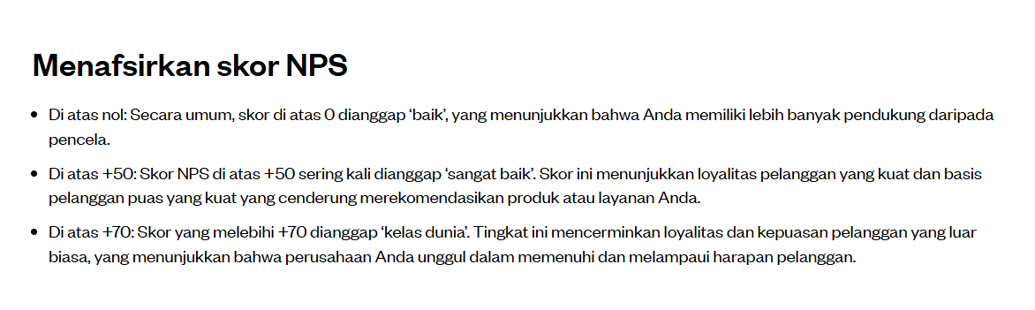
Problem Statement
The management wants us to review the data to increase customer satisfaction and has provided us with the NPS metric. Since customer satisfaction correlates with NPS, we can create the following problem statement as :
How to increase NPS from 42.7 to 55 within 12 months?
Reason : Convert NPS from Good to Very Good
Source

Slide 6
Objective
To increase NPS from 42.7 to 55 within 12 months

Slide 7
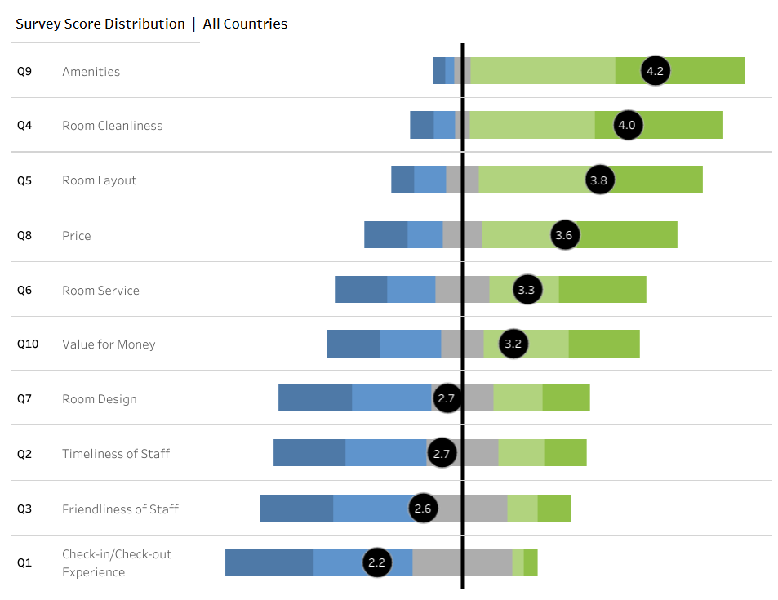
Root Cause
Since we have NPS data, we know that 3 points indicate the boundary between guest satisfaction and dissatisfaction. This means that when the score is below 3 points, it indicates that the guest is unsatisfied. So we can simply determine the root cause as :

Slide 8
Root Cause
Low Timeliness of Staff Score
Quality of The Staff & Service
Low Friendliness of Staff’s Score
How to Increase NPS from 42.7 to 55?
Very Low Score of Check In and Check Out Experience
Bad Interior and Visual Design and Room
Room Facilities and Quality

Slide 9
Hypotheses
We have NPS data, so we can prioritize by focusing on the lowest survey scores.

Slide 10
Hypotheses
Root Causes | Hypotheses | Prioritization
Low Timeliness of Staff Score | If the staff take longer to respond to guest requests, the customers will feel ignored and unsatisfied, leading to a lower NPS | High
Low Friendliness of Staff’s Score | If the staff's friendliness is low, guests will feel unwelcome and unsatisfied with the service, which can lead to a lower NPS | Very High
Low Friendliness of Staff’s Score | If check-in takes more than 5 minutes and checkout exceeds 3 minutes, the guest's first impression will suffer, significantly reducing satisfaction and leading to lower NPS scores. | Very High
Bad Interior and Visual Design and Room | If the room design outdated or lacks cohesive design elements, it will reduce satisfaction and lower the NPS | Mid
Note: The priority is based on the rates from the lowest to the highest as shown on the Dashboard

Slide 11
Metrics
Provide 3 actionable metrics with rational reason and clear
Prioritized Hypotheses | Metrics | Reasoning
If check-in/checkout wait time more than 5 minutes the guest's impression will suffer, significantly reducing satisfaction and leading to lower NPS scores. | Average Wait Time Before Check-in/Check-out | This metric can show us how long guests need to wait and lead us understand the causes of longer wait times
If the staff's friendliness is low, guests will feel unwelcome and unsatisfied with the service, which can lead to a lower NPS | Customer Satisfaction Score (CSAT) for Friendliness | CSAT for Friendliness captures guest perceptions of how friendly and welcoming the staff are
If the staff take longer to respond to guest requests, the customers will feel ignored and unsatisfied, leading to a lower NPS | Average Response Time to Guest | This metric directly captures how quickly staff respond to guest requests

